Slide 1

Analysing codons of different versions of COVID 19

Slide 2
Group 13
13 members
Ashutosh Chauhan
Vitthal Inani
Anunay Alok
Abhinav Anand
Nitin Kumar Chauhan
Raghuram Devalla
Ashutosh Singh
Shardul Gedam
Maurya Babu Vundrajavarapu
Mani Rajeev Kakula
Sai Sampath Boddu
Abhijit Patil
Atharva Dhabekar
Sumanth Bhat

Slide 3

COVID 19 Codon Analysis
Today's Agenda
Analyze the COVID-19 DNA sequence data
Reciprocate on other COVID 19 Variations
Analyse the similarities using Graphs and other data structures

Slide 4

INTRODUCTION
Coronaviruses are a large family of viruses that can cause illnesses ranging widely in severity. The first known severe illness caused by a coronavirus appeared with the 2003 Severe Acute Respiratory Syndrome (SARS) epidemic in China. A second outbreak of severe illness originated in 2012 in Saudi Arabia with the Middle East Respiratory Syndrome (MERS). And now the ongoing outbreak of COVID-19.

Slide 5



Using BioPython
Analysis using BioPython
The BioPython project is an open-source collection of non-commercial Python tools for computational biology and bioinformatics. The Coronavirus Genome Sequence dataset is available to download from Kaggle.
Concept
The coronaviruses are members of a family of enveloped viruses that replicate in the cytoplasm of animal host cells. They are identified by the presence of a single-stranded plus-sense RNA genome((+)ssRNA classification of viruses) about 30 kb in length that has a 5′ cap structure and 3′ polyadenylation tract.
Analysis
Using BioPython, we transcribe the COVID-19 DNA sequence into the RNA sequence, which we then translate into the Amino Acid sequence. Each codon consists of three nucleotides, usually corresponding to a single amino acid.

Slide 6
The Code
Using BioPython
We Used BioPython, numpy, seaborn to access fasta data from NCBI.

Slide 7
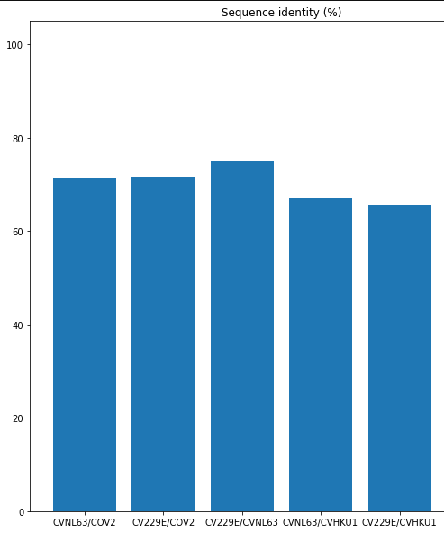
Look at the Results
The three most common corona viruses
CVNL 63
The human coronavirus NL63 (HCoV-NL63) was first identified in the Netherlands and its France.
CV229E /CVHKU1
CV229E /CVHKU1

Slide 8
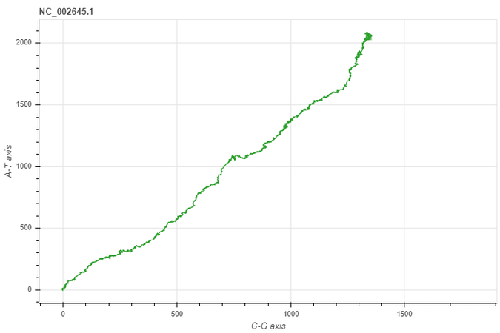
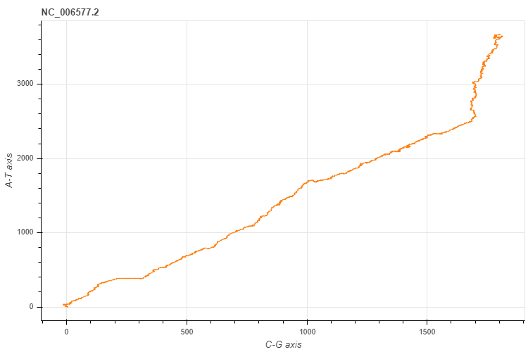
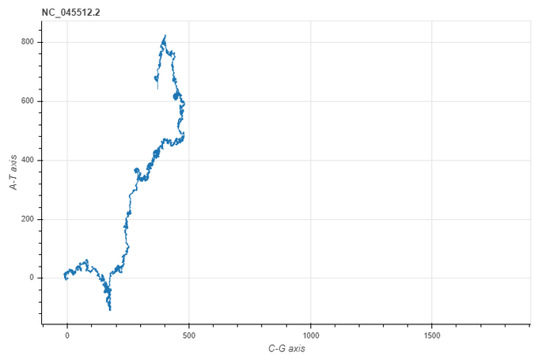
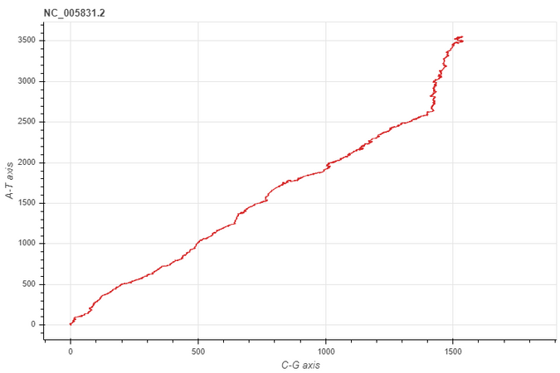
DNA Sequence visualisation
CV229E
CVHKU1
COV2
CVNL63

Slide 9
OBSERVATIONS
We got the number of Leucine(L) and Valines(V) high in this protein which indicates a good number of Alpha-Helices, which is a common motif in the secondary structure of proteins.
2
As we can observe from the DNA visualization, the DNA structure of COV2 and SARS are almost identical, while that of MERS is a little different than the two.
Phylogenetic analysis of the complete viral genome (29,903 nucleotides) revealed that the COVID-19 virus was most closely related (83.3% nucleotide similarity) to a group of SARS-like coronaviruses (genus Betacoronavirus, subgenus Sarbecovirus) that had previously been found in bats in China.
1
3

Slide 10
https://www.ncbi.nlm.nih.gov/genome
https://www.kdnuggets.com/2020/04/coronavirus-covid-19-genome-analysis-biopython.html
Resources
https://biopython.org/

